Slide 1



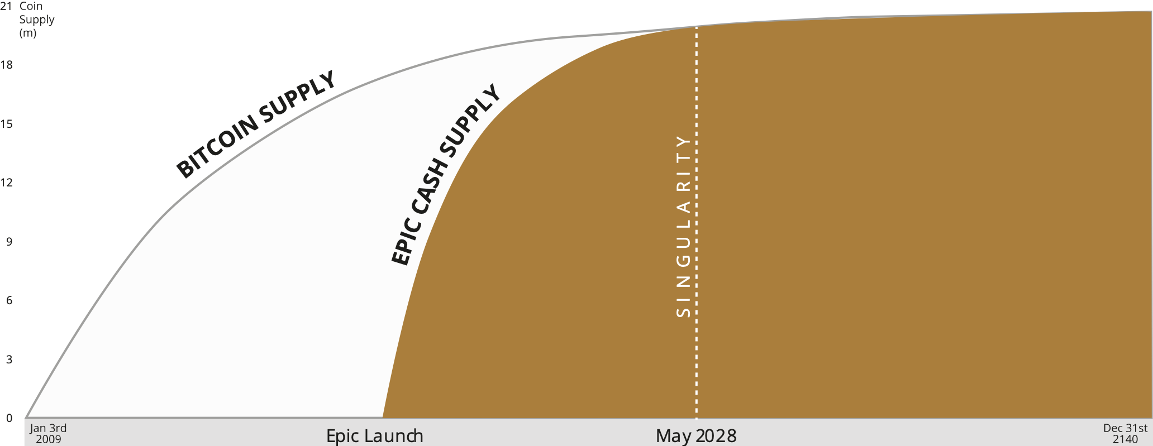
SCARCITY
Why is it important for a currency?
When an arbitrary quantity can be created there is nothing to stop those who control the printing from making more.
90%
THE SUPPLY OF FEDERAL RESERVE NOTES HAS INCREASED >70% OVER THE PAST YEAR
60%
30%
2016
2017
2018
2019
2020
2021
0
Source: Board of Governors of the Federal Reserve System (US)
“A few trillion for my pals, $1200 for you!”
EPIC is the hardest money ever created. There are only 11,000 coins issued daily, a figure guaranteed to decline by 50%, to 5.5k coins in October 2021. This process continues such that by May 2028, daily supply creation declines by 98%, from 11,000 to 210 coins daily. This is hard-coded and can never be changed. Censorship resistant, unconfiscatable, cost effective, energy efficient, fungible P2P electronic cash on an open, public, permissionless, borderless, neutral blockchain is considered by many to be the “Holy Grail of Money”. 21 million coins for 8 billion people. Can you afford not to own one?
1 BTC $55k
1 EPIC $1.12*
Supply: 18.5m
New EPIC & BTC supply drops over time regardless of price
Supply: 10.6m
* Not $1.12k, but the price of a coke
Same full Nakamoto Consensus, less centralized, less costly, less environmental impact. Epic is not the next Bitcoin or a better Bitcoin. It IS Bitcoin, the way it started: fast, mineable by ordinary people with home computers, cheap, uniquely useful. Learn more at epic.tech
21M MAXIMUM SUPPLY DEC 2140
Scarcity One Pager v0.3 24th Feb 2021

